Slide 1
American Sign Language
CSC-215 Final Project
Zainiya Manjiyani

Slide 2
Outline
Dataset
Overall Flow
Preprocessing
Machine Learning Models
Results

Slide 3
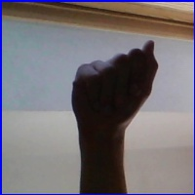
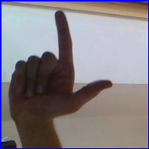
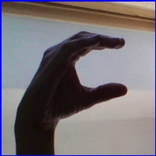
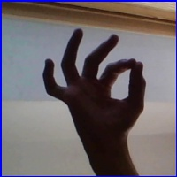
Dataset
I have used American Sign Language dataset available on https://www.kaggle.com/grassknoted/asl-alphabet
It contains unlabeled ASL images as shown
Notes:
Size of data set
Paper that you read result : 89% because of light
They have used total of 500 imgs and less amount of data
Ours was also good when used with 20 img and 1 test

Slide 4
Overall Flow
Skin color segmentation
Model here is any of the classification models implemented.
Preprocessing
Image labeling
Training/Testing?
Training
Testing
Apply image to model for training
Apply image to model for prediction
Find accuracy

Slide 5

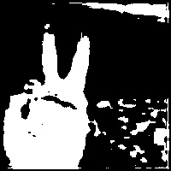
Preprocessing
Skin Color Segmentation
  Converted Image from RGB to YCrCb format
  If pixel value in YCrCb is between (0, 133, 77) and (255, 173, 127) then displayed as white otherwise black
Image Segmentation

Slide 6
Machine Learning Models

Slide 7
Machine Learning Models
Convolution Neural Network(CNN)
Fully connected Neural Network
Long Short Term Memory networks
Ensemble methods
Naive Bayes
K-Nearest Neighbor
Logistic Regression
Semi-supervised learning
Support Vector Machine(SVM)
Decision tree

Slide 8
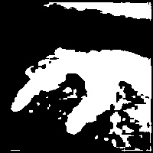
Convolution Neural Network
Pooling
Pooling
Fully connected NN
O/p
Convolution
Convolution
Convolution

Slide 9
Convolution Process
0
1
1
0
0
1
1
1
0
1
1
1
2
kernel
1
1
0
0
1
1
1
1
0
0
1
1
0
1
1
1
2
0
1
1
1
1
1
1
1
1
0
1
1
1
0
1
1
Convolution
(0x1)+(1x1)+(1x1)+(1x0)

Slide 10
Fully Connected Neural Network
W₀
...
W₁
W_{n}
Input Hidden layers Output

Slide 11
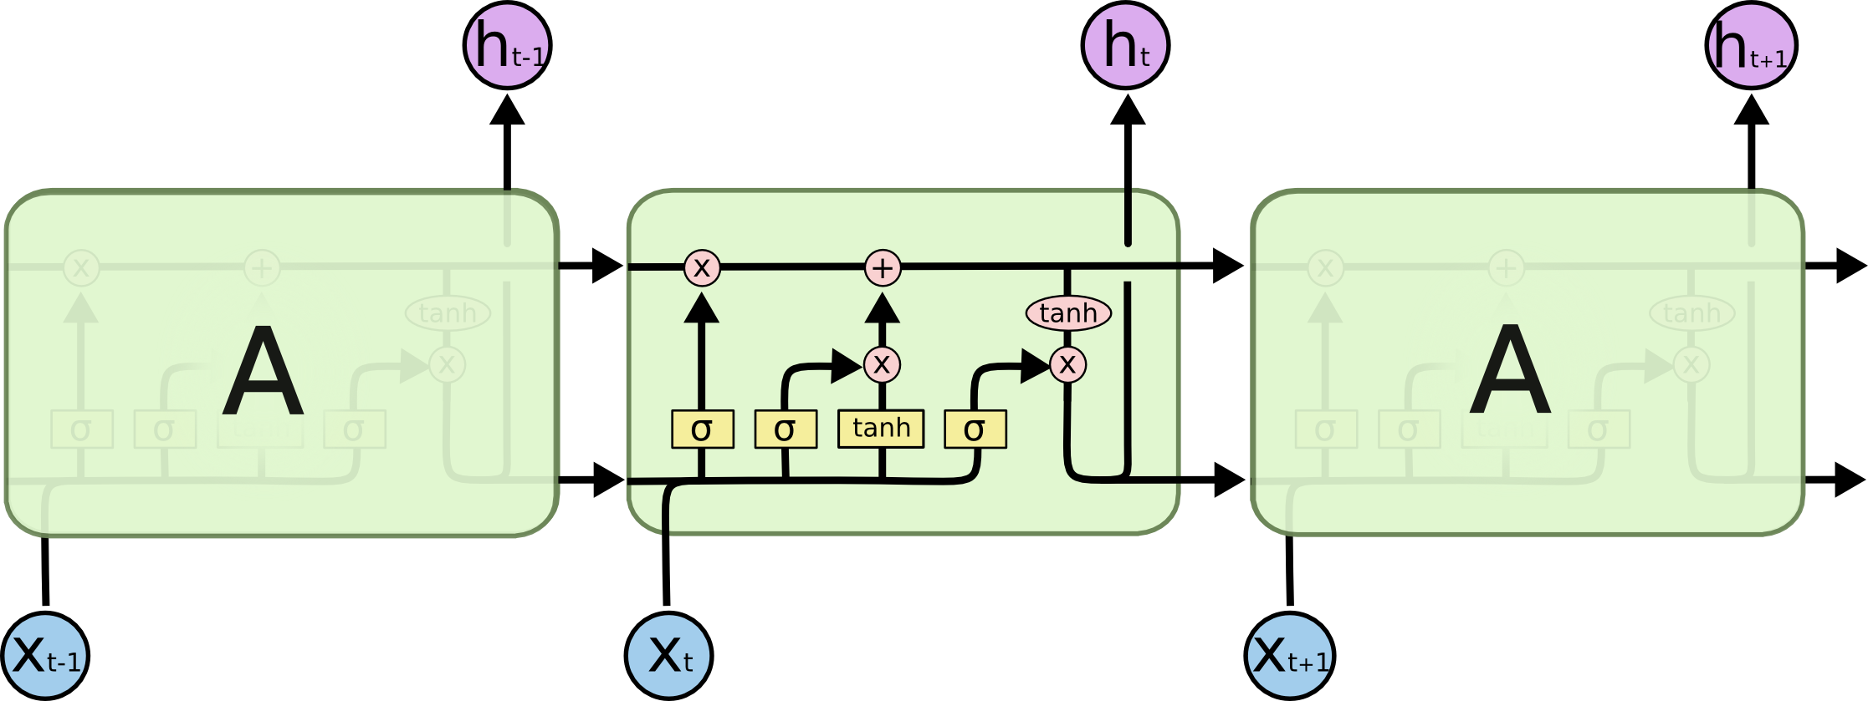
LSTM
LSTM network is a special type of Recurrent Neural Network(RNN).
The downside of RNN is long term dependency problem and LSTM is designed to overcome it.

Slide 12
Combination of CNN, LSTM, NN
CNN
LSTM
NN
Input
Output

Slide 13
Ensemble Methods
Two types
  Averaging: Average of predictions of all baseline algorithms, examples are: bagging classifier, random forest classifier
  Boosting: Baseline algorithms does prediction sequentially and try to minimize bias in predictions, example: AdaBoost
Implemented following methods
  AdaBoost classifier
  Bagging classifier
  Random forest classifier
  Voting classifier
Notes:
Akshada explained about ensemble methods

Slide 14
Naive Bayes
Methods which uses Bayes theorem to find conditional independence between each pair of feature and class value
Different naive Bayes classifier makes different assumptions for calculating this independence between pair of feature and class label
Have implemented following methods:
  Gaussian NB
  Bernoulli’s NB
  Multinomial NB

Slide 15
K-Nearest Neighbor
Widely used for classification
To predict the class label we find predefined number of sample closest to that point and based on the label of those samples we predict label for new point
Number of samples is determined by parameter “k” that is why this method is called K-nearest neighbor algorithm

Slide 16
Logistic Regression
Despite its name this method is used as a linear model for classification rather than regression.
The core of logistic regression is logistic function which is an equation, mostly linear. Input values and associated weights (or coefficients) are given as an input to the equation to predict output value.

Slide 17
Semi-supervised Learning
Semi-supervised learning methods are used when there are some class labels missing in the training dataset.
I have used two semi-supervised learning methods:
  Label propagation
  Label spreading.

Slide 18
Support Vector Machine
Training data are represented as a points in n-dimensional space where n is a number of features.
The idea here is to find a hyperplane in n dimensional space that can distinctly classify the data points.
Support vectors
I have implemented three methods:
SVC
Linear SVC
Nu SVC
Y
hyperplane
X

Slide 19
Decision Tree
During training it infers decision rules from training data and make decision tree using it.
The deeper the tree the more complex the decision tree rules are and fitter the tree.
At the time of prediction it parse the data using decision tree.
I have used two methods in this project:
  Decision tree classifier
  Extra tree classifier

Slide 20
Results

Slide 21
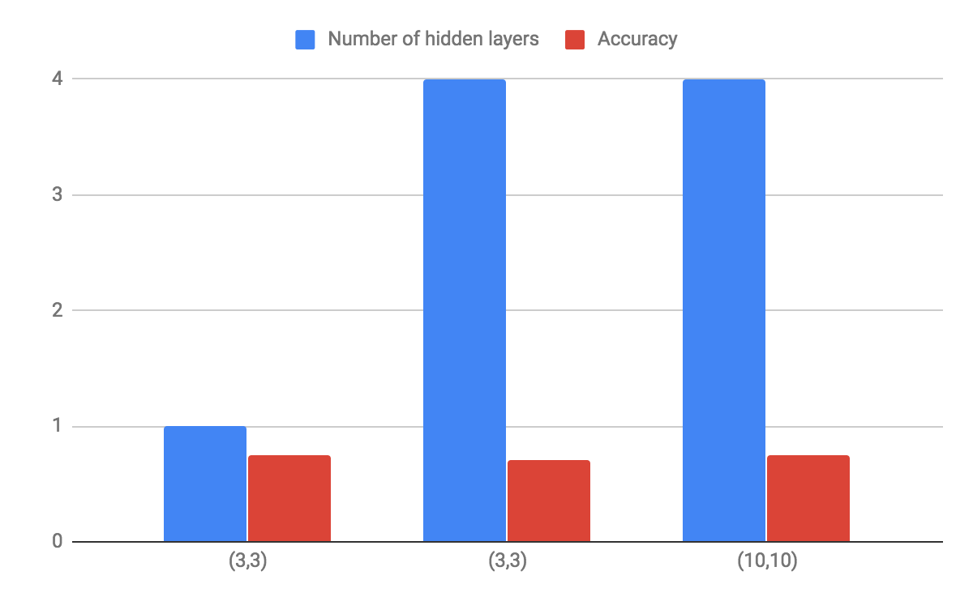
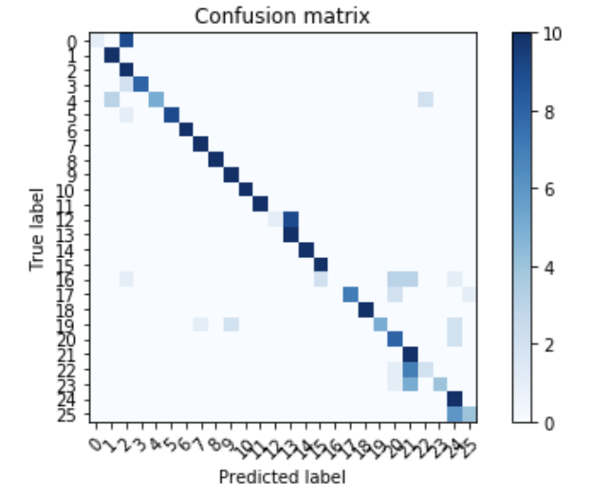
CNN
No | CNN L1 |  | CNN L2 |  | Number of hidden layers | Accuracy
 | Kernel | Filter | Kernel | Filter
1 | (3,3) | 200 | (1,2) | 167 | 1 | 75.38%
2 | (3,3) | 200 | (1,2) | 500 | 4 | 71.15%
3 | (10,10) | 200 | (5,5) | 300 | 4 | 74.62%

Slide 22
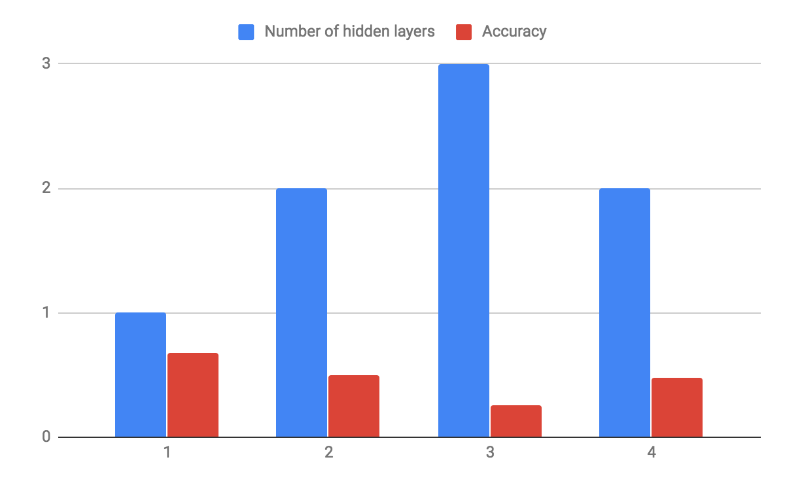
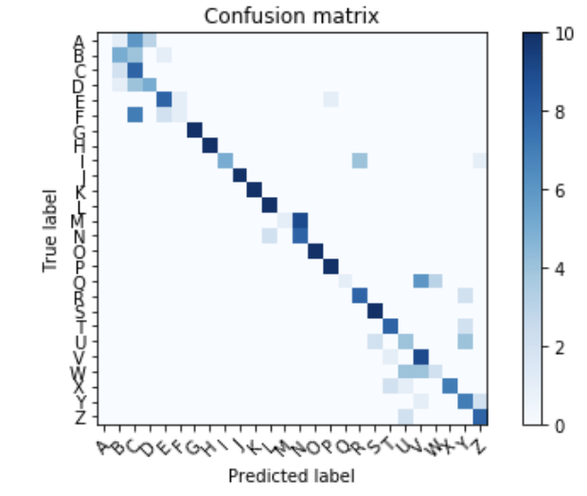
LSTM
No | LSTM | Number of hidden layers | Accuracy
1 | 128 | 1 | 68.07%
2 | 128 | 2 | 50%
3 | 128 | 3 | 26%
4 | 435 | 2 | 48.07%

Slide 23
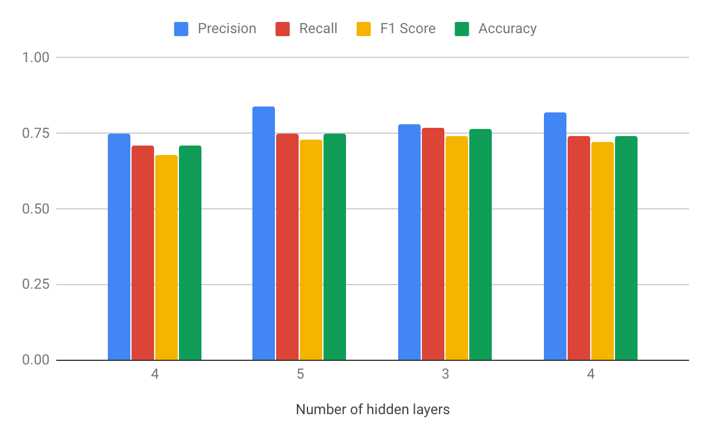
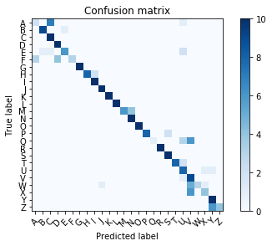
Fully Connected Neural Network
No | H1 | H2 | H3 | H4 | H5 | Accuracy
1 | 100 | 150 | 60 | 30 |  | 71.15%
2 | 200 | 500 | 150 | 97 | 30 | 75%
3 | 200 | 500 | 97 |  |  | 76.53%
4 | 400 | 656 | 379 | 147 |  | 74.23%

Slide 24
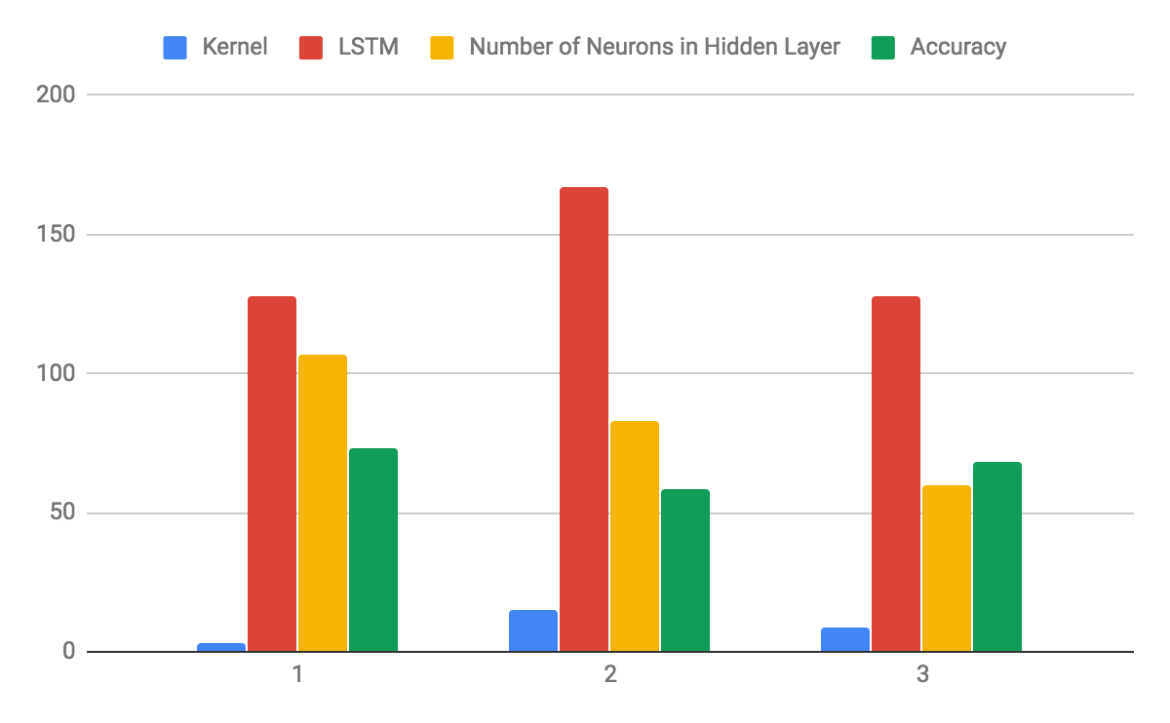
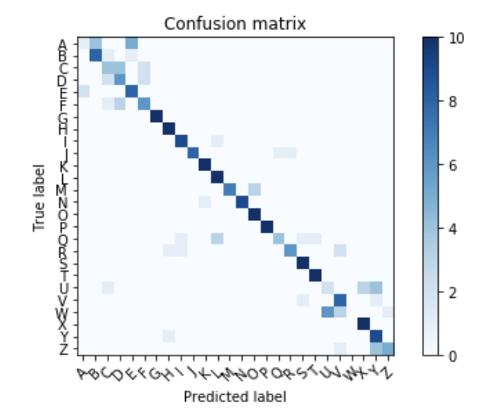
Combination of CNN, LSTM and NN
No | CNN |  | LSTM | Number of Neurons in Hidden Layer | Accuracy
 | Kernel | Filter
1 | 3 | 200 | 128 | 107 | 73.40%
2 | 15 | 250 | 167 | 83 | 58.46%
3 | 9 | 200 | 128 | 60 | 68.46%

Slide 25
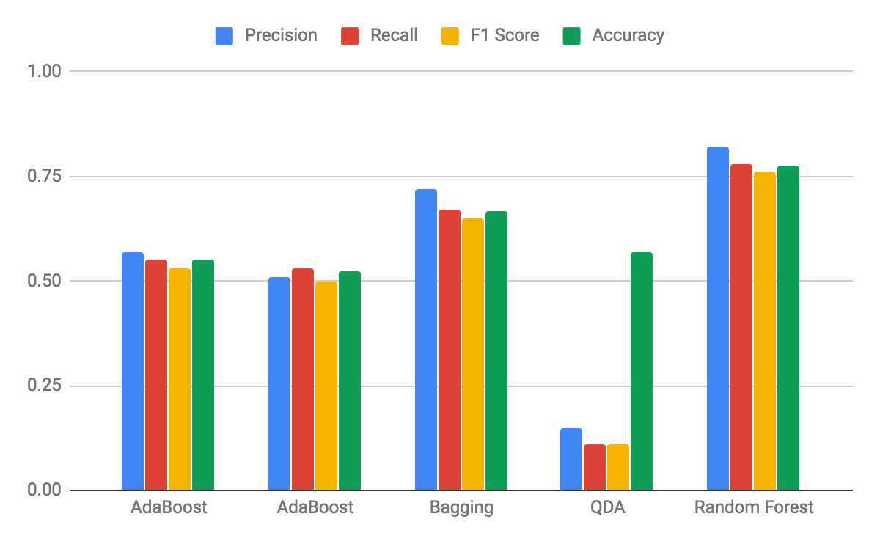
Ensemble Methods
No | Classifier Name | Base estimator | Precision | Recall | F1 Score | Accuracy
1 | AdaBoost | Decision Tree Classifier | 0.57 | 0.55 | 0.53 | 55.19%
2 | AdaBoost | Extra Tree Classifier | 0.51 | 0.53 | 0.5 | 52.50%
3 | Bagging | Decision Tree Classifier | 0.72 | 0.67 | 0.65 | 66.73%
4 | QDA |  | 0.15 | 0.11 | 0.11 | 57%
5 | Random Forest |  | 0.82 | 0.78 | 0.76 | 77.69%

Slide 26
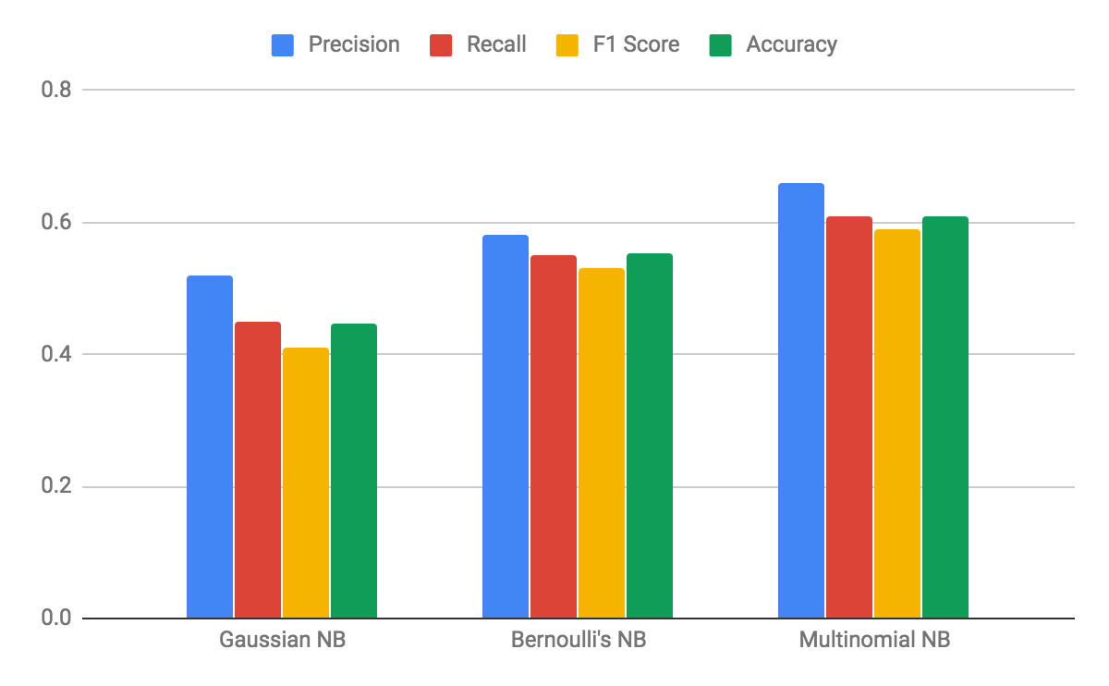
Naive Bayes
No | Methods | Precision | Recall | F1 Score | Accuracy
1 | Gaussian NB | 0.52 | 0.45 | 0.41 | 44.80%
2 | Bernoulli's NB | 0.58 | 0.55 | 0.53 | 55.19%
3 | Multinomial NB | 0.66 | 0.61 | 0.59 | 60.96%

Slide 27
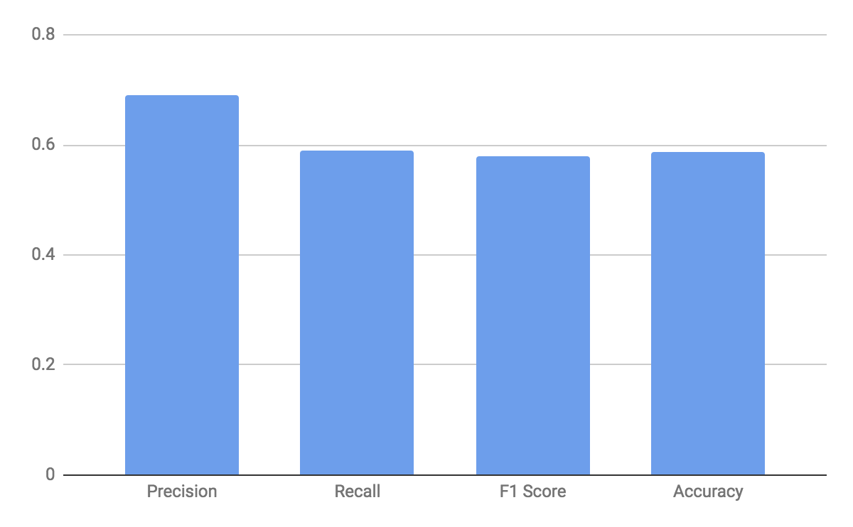
K-Nearest Neighbor
Precision | Recall | F1 Score | Accuracy
0.69 | 0.59 | 0.58 | 58.65%

Slide 28
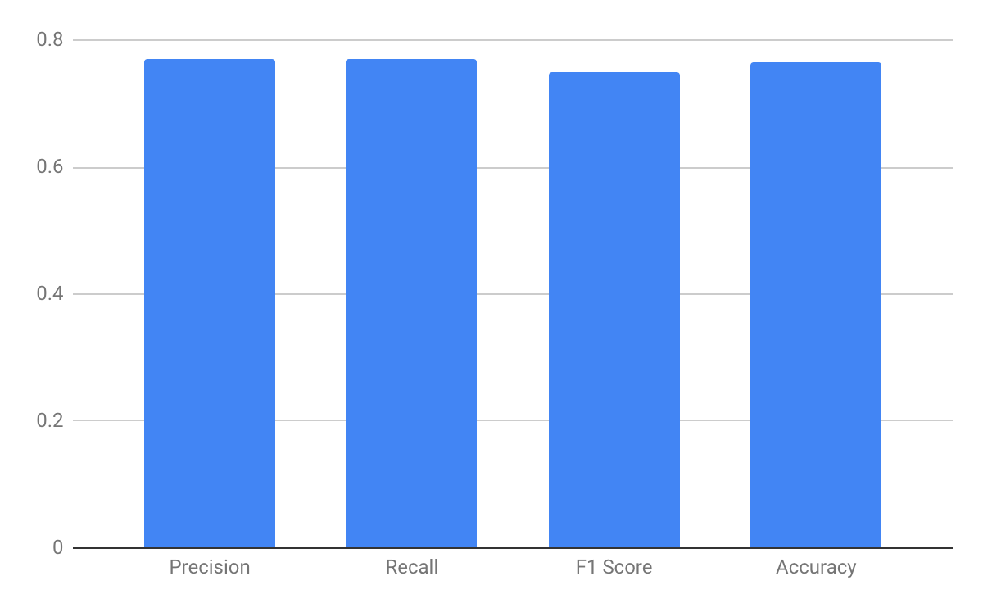
Logistic Regression
Precision | Recall | F1 Score | Accuracy
0.77 | 0.77 | 0.75 | 76.53%

Slide 29
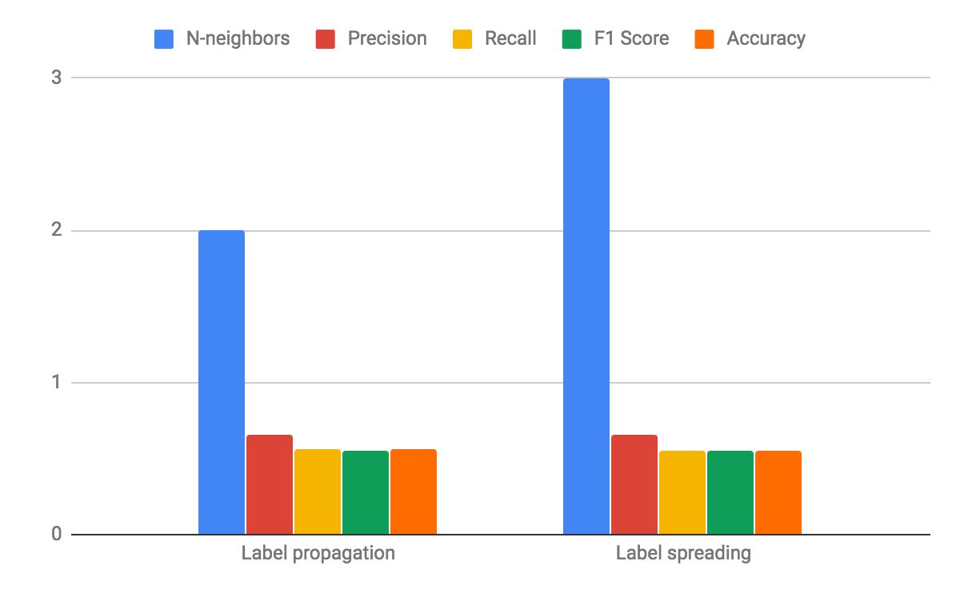
Semi-supervised Learning
No | Method | N-neighbors | Precision | Recall | F1 Score | Accuracy
1 | Label propagation | 2 | 0.66 | 0.56 | 0.55 | 55.96%
2 | Label spreading | 3 | 0.66 | 0.55 | 0.55 | 55.38%

Slide 30
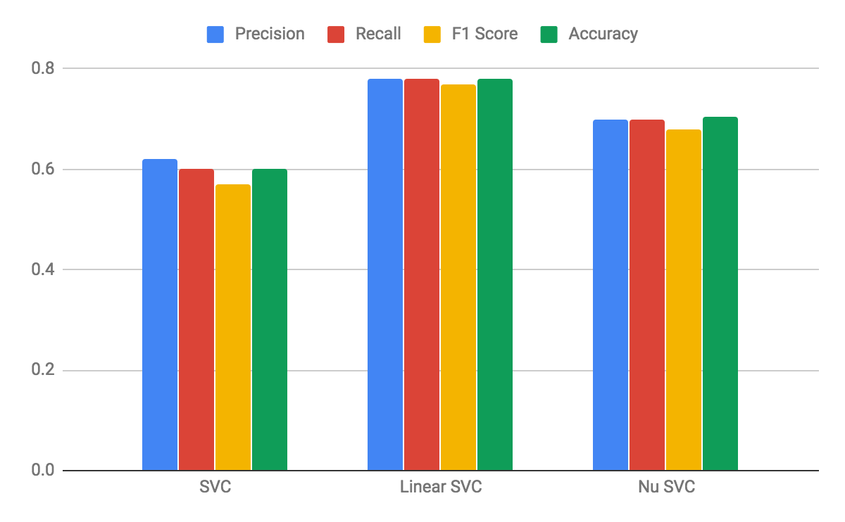
SVM
No | Method | Precision | Recall | F1 Score | Accuracy
1 | SVC | 0.62 | 0.6 | 0.57 | 60%
2 | Linear SVC | 0.78 | 0.78 | 0.77 | 77.88%
3 | Nu SVC | 0.7 | 0.7 | 0.68 | 70.38%

Slide 31
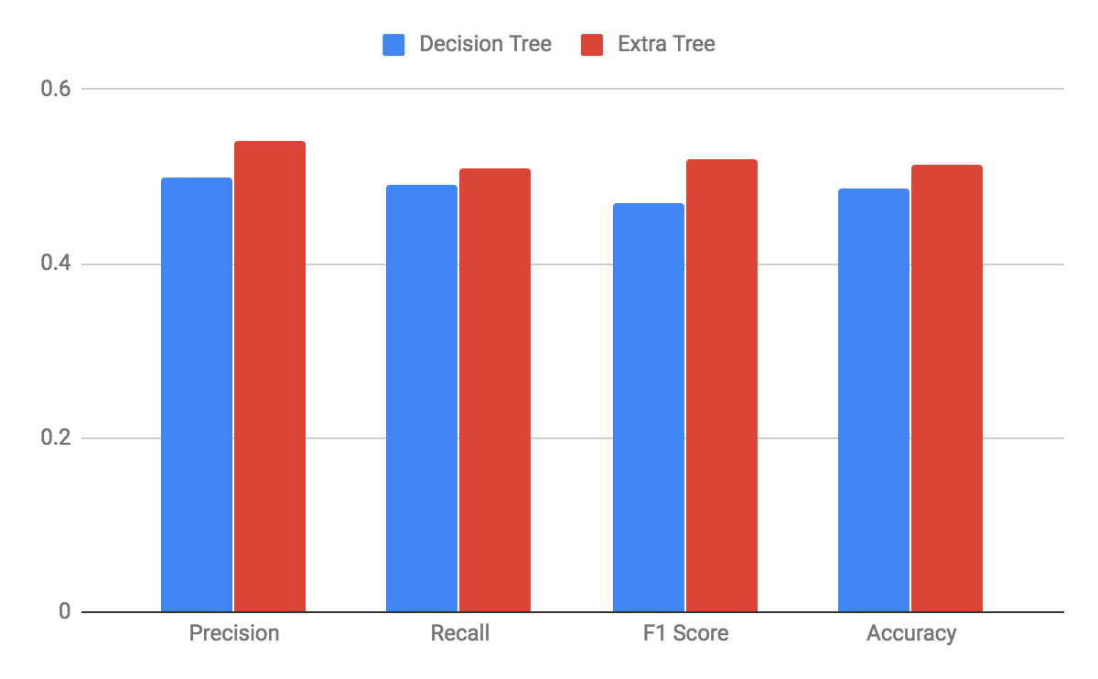
Decision Tree
No | Classifier | Precision | Recall | F1 Score | Accuracy
1 | Decision Tree | 0.5 | 0.49 | 0.47 | 48.65%
2 | Extra Tree | 0.54 | 0.51 | 0.52 | 51.34%

Slide 32
Conclusion
Top three accuracies
  SVC (77.88%)
  Random Forest (77.69%)
  Neural Network (76.53%)

Slide 33
Thank You

